Slide 1
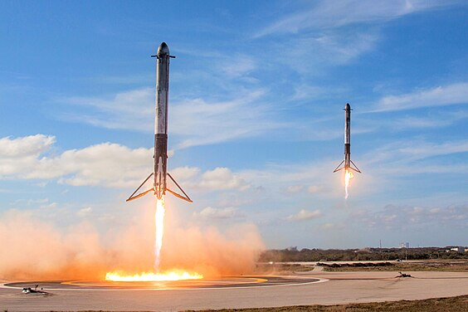






Falcon 9 First-Stage Landing Model
NAYAN AGRAWAL
06/09/2023

Slide 2



OUTLINE
Executive Summary
Introduction
Methodology
Results
Visualization – Charts
Dashboard
Discussion
Findings & Implications
Conclusion
Appendix

Slide 3

EXECUTIVE SUMMARY
The primary objective of this project is to construct a predictive model capable of determining the likelihood of a successful landing for the first stage of the Falcon 9 rocket. Our analysis leverages a substantial dataset sourced from SpaceX and Wikipedia, encompassing extensive information on Falcon 9 rockets, including launch and landing outcomes.
In the pursuit of insights, we employed various data visualization techniques to uncover correlations between different variables that may influence the landing success of the Falcon 9 rocket.
To fulfill our predictive goals, we have undertaken the development and evaluation of several machine learning models, including but not limited to linear regression, multiple regression, decision trees, and K-nearest neighbors (KNN). These models have been rigorously tested and refined to ensure their effectiveness in forecasting the first stage landing outcome.
Our findings and predictive models offer valuable insights into the complex factors influencing Falcon 9 first stage landings, providing a robust foundation for informed decision-making and operational enhancements within the realm of space exploration and rocket technology.

Slide 4

INTRODUCTION
SpaceX, under the visionary leadership of Elon Musk, has revolutionized the aerospace industry by developing cutting-edge technologies and pushing the boundaries of space exploration. Among its remarkable achievements, the Falcon 9 rocket stands as a testament to innovation and reusability. One of the key challenges in rocket reusability is ensuring the successful landing of the first stage of the Falcon 9 rocket after launch.
This data analysis report delves into the heart of this challenge, aiming to create a predictive model capable of forecasting whether the first stage of the Falcon 9 rocket will achieve a safe landing. Drawing upon a rich and comprehensive dataset sourced from SpaceX and Wikipedia, we embark on a journey to decipher the intricate web of factors that influence the outcome of these landings.
Our mission is two-fold: firstly, to employ data visualization techniques to uncover hidden correlations within this dataset, and secondly, to develop a suite of machine learning models, including linear and multiple regressions, decision trees, and K-nearest neighbors (KNN), to predict the success of Falcon 9 first stage landings. Through a meticulous and data-driven approach, we endeavor to unlock insights that not only contribute to the advancement of space technology but also inform future decisions and strategies in the realm of space exploration.
This report is a testament to our commitment to harnessing the power of data to overcome complex challenges and to contribute to the ongoing story of human exploration beyond our planet. It represents a fusion of data science, engineering, and the unrelenting pursuit of innovation, reflecting the spirit of SpaceX itself. As we delve into the depths of this analysis, we invite you to join us on this journey of discovery and insight into the fascinating world of rocketry and space technology.

Slide 5
METHODOLOGY
The foundation of our data analysis project lies in a systematic and rigorous methodology that encompasses data collection and the crucial data preparation phase. This methodology is pivotal in ensuring the integrity and relevance of the data utilized for our modeling endeavors.
Data Sources:
Our data collection process draws from two primary sources, each contributing essential components to our analysis:
SpaceX API: This invaluable resource provides a wealth of information, including booster version details, payload specifications, orbital data, launch dates, and most importantly, the outcome of Falcon 9 rocket launches.
Wikipedia: We have meticulously compiled historical data on Falcon 9 launches from Wikipedia. This dataset contains comprehensive records of launch events, detailing whether each launch was deemed a success or faced issues.
Data Wrangling:
The subsequent step in our methodology is data wrangling, a critical phase dedicated to refining and preparing the collected data for analysis. This stage involves a series of steps aimed at enhancing the quality and usability of the dataset:
Data Cleaning: We meticulously clean the collected data, eliminating any inconsistencies, inaccuracies, or irrelevant information. This process ensures that the dataset is free from noise and errors that could adversely affect our modeling efforts.
Data Organization: To facilitate efficient analysis, we organize the collected data into a structured, tabular format. This tabulation allows for easy access, manipulation, and interpretation of the information.
Variable Bifurcation: We categorize the data into two fundamental categories: independent variables and dependent variables. This clear demarcation is essential for training and evaluating our predictive models. Independent variables serve as the inputs, while the dependent variable represents the outcome we aim to predict – in this case, the success or failure of Falcon 9 rocket landings.

Slide 6
METHODOLOGY
Data Visualization:
Building upon the foundation of our data collection and preparation efforts, we transition into the realm of data visualization, a pivotal stage in our methodology. Here, we delve into Exploratory Data Analysis (EDA), which involves the use of various visualization techniques to unveil the concealed insights residing within the dataset. Our primary objective during this phase is to unearth correlations between the dependent and independent variables, empowering us to train our machine learning models effectively.
We harness a diverse array of visualization tools, including scatter plots, categorical plots (catplot), bar charts, and line charts. Through these visualizations, we gain a deeper understanding of the data's underlying patterns, facilitating the model training process.
Training the Models:
With a comprehensive understanding of our data gleaned from the Descriptive Analysis phase, we proceed to the pivotal stage of model training. Here, we define and create multiple machine learning models, including but not limited to Logistic Regression, Decision Trees, K-nearest Neighbors (KNN), and Support Vector Machines (SVM). Each of these models is meticulously crafted to capture the nuances of the Falcon 9 landing outcomes.
To assess the performance of these models, we employ confusion matrices and accuracy metrics. This rigorous evaluation process allows us to quantitatively compare the models and select the one that demonstrates the highest predictive accuracy. The chosen model serves as a powerful tool for forecasting Falcon 9 first stage landing success.
Dashboard Creation:
Upon the successful training and selection of the optimal machine learning model, we transition to the final phase of our methodology—dashboard creation. This interactive dashboard serves as a user-friendly interface, providing easy access to valuable information regarding Falcon 9 rockets and their outcomes.
The dashboard offers users the ability to retrieve data based on specific criteria such as launch site and payload amount. Visualizations in the form of pie charts and scatter plots offer intuitive insights into the success or failure of Falcon 9 rocket landings, enhancing accessibility and facilitating data-driven decision-making.
This comprehensive methodology, encompassing data collection, preparation, visualization, model training, and dashboard creation, equips us with a powerful framework for not only uncovering the hidden dynamics of Falcon 9 landings but also for presenting these insights in a user-friendly and actionable format. Our ultimate goal is to contribute to the broader understanding of space technology and provide a valuable resource for stakeholders in the field of space exploration.

Slide 7
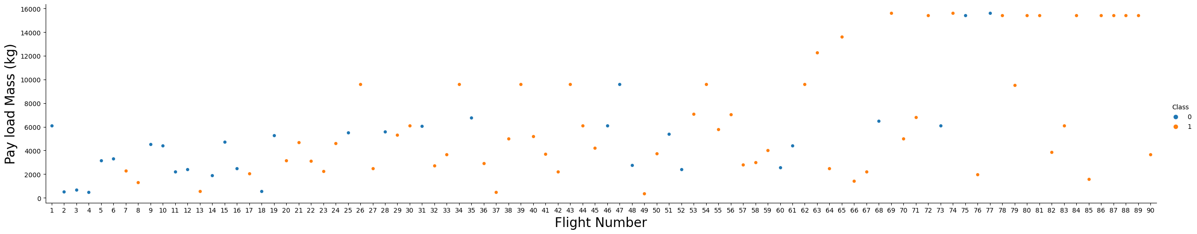
RESULTS
In this section, we present the outcomes of our data analysis journey, which involved data collection, preparation, visualization, model training, and dashboard creation. Our efforts aimed to unravel the intricate factors influencing the success of Falcon 9 rocket first stage landings and to provide a user-friendly interface for accessing these insights.
The categorical plot vividly illustrates a compelling trend: as Flight Number increases, the Payload Mass (Kg) also shows a consistent upward trajectory. This finding suggests a progressive increase in the capacity and efficiency of Falcon 9 rockets over successive flights, enabling them to carry larger payloads into space.
Furthermore, the categorical plot provides an intriguing insight into the relationship between Payload Mass and the Outcome of Falcon 9 landings. It is evident that successful landings are more prevalent in cases involving higher Payload Mass. This observation implies that, as the Falcon 9 rockets evolve to handle heavier payloads, they also demonstrate an improved capability for successful landings.

Slide 8
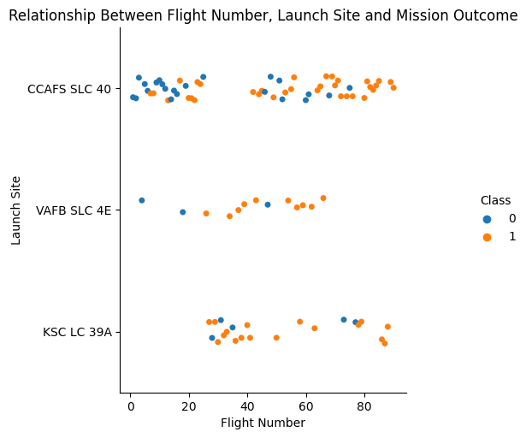
RESULTS
This categorical plot prominently highlights several key observations:
Launch Site Dominance: It is readily apparent that the majority of Falcon 9 launches occur from the Cape Canaveral Air Force Station (CCAFS) Space Launch Complex 40 (SLC 40) site. This site serves as a central hub for Falcon 9 missions, reflecting its significance in SpaceX's launch operations.
Flight Number and Success: The plot also demonstrates a notable trend—higher Flight Numbers correlate with a higher likelihood of a successful landing outcome. This observation suggests a maturation and refinement of Falcon 9 technology over time, resulting in improved success rates for later flights.
VAFB SLC 4E Success: In contrast, the Vandenberg Air Force Base (VAFB) Space Launch Complex 4E (SLC 4E) launch site stands out as a site with a relatively higher proportion of successful landings. This site's performance suggests unique operational advantages or technological enhancements that contribute to more successful outcomes compared to other launch sites.

Slide 9
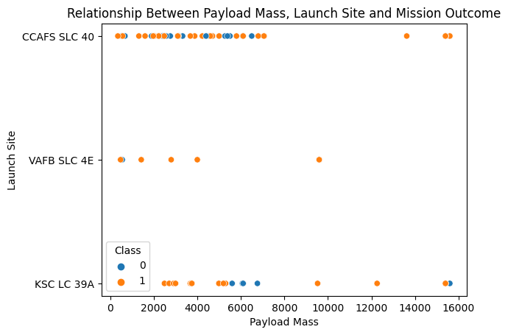
RESULTS
The key findings from this scatter plot are as follows:
Payload Mass and Success: The scatter plot unequivocally illustrates that as Payload Mass surpasses the threshold of 10,000 kg, the likelihood of a Successful Outcome (denoted as 1) approaches a near 100% rate. This finding underscores the robustness and reliability of the Falcon 9 rocket in handling larger payloads, resulting in a remarkably high success rate for such missions.
VAFB SLC 4E Success: Particularly noteworthy is the launch site, Vandenberg Air Force Base (VAFB) Space Launch Complex 4E (SLC 4E), which exhibits an exceptional nearly 100% success rate for missions with payloads less than 10,000 kg. This suggests that VAFB SLC 4E is exceptionally well-suited for handling smaller payloads, likely due to specific operational advantages or technological capabilities.
KSC LC 39A Success: The scatter plot further reveals that the Kennedy Space Center (KSC) Launch Complex 39A (LC 39A) launch site achieves an impressive near 100% success rate for missions with payloads ranging from 2,000 kg to 5,000 kg and payloads between 10,000 kg and 16,000 kg. This versatile success across payload ranges emphasizes the launch site's adaptability and effectiveness in a variety of mission scenarios.

Slide 10
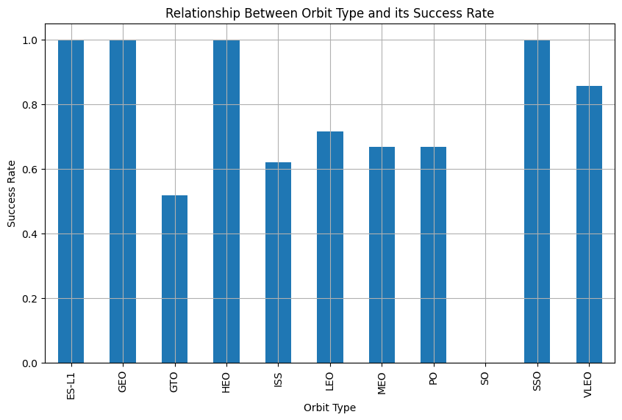
RESULTS
The key observations derived from this bar plot are as follows:
High Success Rates: Notably, the bar plot vividly showcases that certain Orbit Types consistently achieve a remarkable 100% success rate. These include ES-L1, GEO, HIEO, and SSO. This indicates an impressive level of reliability and effectiveness in launching Falcon 9 rockets into these specific orbit types, bolstering their status as preferred choices for mission planners.
Challenges with GTO: In contrast, the bar plot highlights that the orbit type GTO (Geostationary Transfer Orbit) exhibits a comparatively lower success rate, standing at 50%. This suggests that missions targeting GTO orbits present unique challenges or complexities that result in a greater degree of variability in mission outcomes.

Slide 11
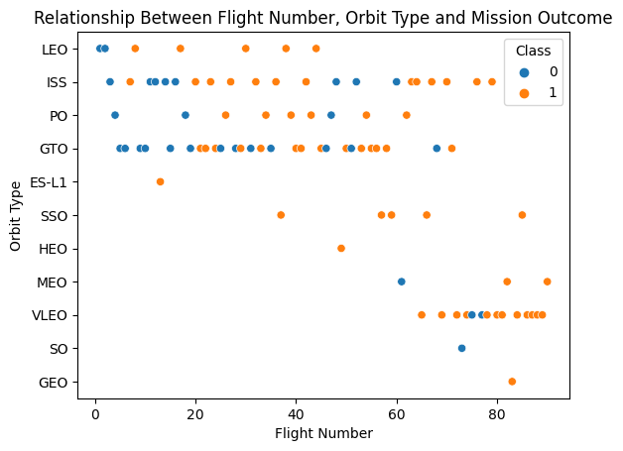
RESULTS
The salient findings derived from this scatter plot are as follows:
LEO and VLEO Success Trends: Notably, the scatter plot illustrates distinct success trends for Low Earth Orbit (LEO) and Very Low Earth Orbit (VLEO). In both of these orbit types, there is a clear and consistent pattern: as Flight Number increases, the success rate of lander landings also exhibits an upward trajectory. This suggests that over successive flights, Falcon 9 rockets demonstrate an increasingly reliable performance, particularly in achieving successful landings for missions targeting LEO and VLEO orbits.
GTO Independence: In stark contrast, the scatter plot indicates that there is no discernible relationship between Flight Number and the success rate for Geostationary Transfer Orbit (GTO) missions. This observation underscores the unique and potentially complex challenges associated with GTO missions, which do not exhibit the same trend of improved success with increasing Flight Number.
High Success for SSO and HEO Orbits: Furthermore, the scatter plot showcases a striking fact—there is a consistent 100% success rate for missions targeting Sun-Synchronous Orbit (SSO) and Highly Elliptical Orbit (HEO). This remarkable level of success suggests the robustness and reliability of Falcon 9 missions in achieving successful landings for these specific orbit types.

Slide 12
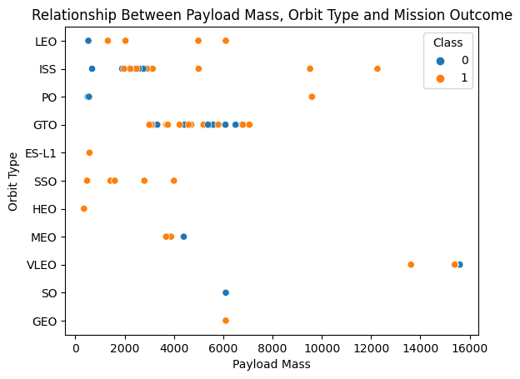
RESULTS
The pivotal insights derived from this scatter plot are as follows:
High Payload Mass Success: This scatter plot decisively showcases that for heavy payloads, defined as those exceeding 4,000 kg, there exists a remarkable 100% success rate for specific orbit types, including Low Earth Orbit (LEO), International Space Station (ISS), and Polar Orbit (PO). This finding underscores the robustness and reliability of Falcon 9 missions when handling substantial payloads. It suggests that the rocket's capabilities are well-suited for these specific orbits, resulting in consistently successful missions.
Low Payload Mass Success: In stark contrast, the scatter plot reveals a striking observation: for lower payloads, defined as those below a certain threshold, there is a consistent 100% success rate for orbits like Sun-Synchronous Orbit (SSO) and Highly Elliptical Orbit (HEO). This remarkable level of success suggests that Falcon 9 missions excel in achieving positive landing outcomes for these specific orbit types when dealing with smaller payloads.
GTO Complexity: Notably, the scatter plot also illustrates the complexity associated with Geostationary Transfer Orbit (GTO) missions. Here, we find that both positive landing outcomes and unsuccessful missions coexist within this orbit type. The scatter plot does not provide a clear distinction, highlighting the unique challenges and variability associated with GTO missions.

Slide 13
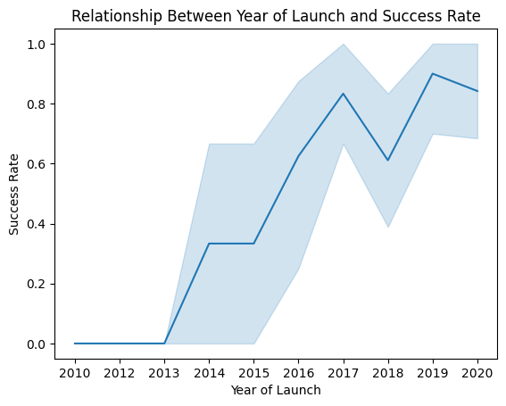
RESULTS
Key observations derived from this line plot analysis are as follows:
Steady Success Rate Increase: The line plot vividly illustrates that from 2013 through 2020, there is a consistent and notable upward trend in the success rate of Falcon 9 rocket first stage landings. This trend underscores the rocket's increasing reliability and effectiveness during this period, reflecting advancements in technology, operational efficiencies, and cumulative experience.
2018 Anomaly: While the overall trajectory is one of success rate improvement, there is a noteworthy anomaly in 2018, where a slight dip in success rate is observed. This dip suggests that this particular year presented unique challenges or anomalies that affected mission outcomes. Further investigation into the events of 2018 may provide valuable insights into these temporary setbacks.

Slide 14
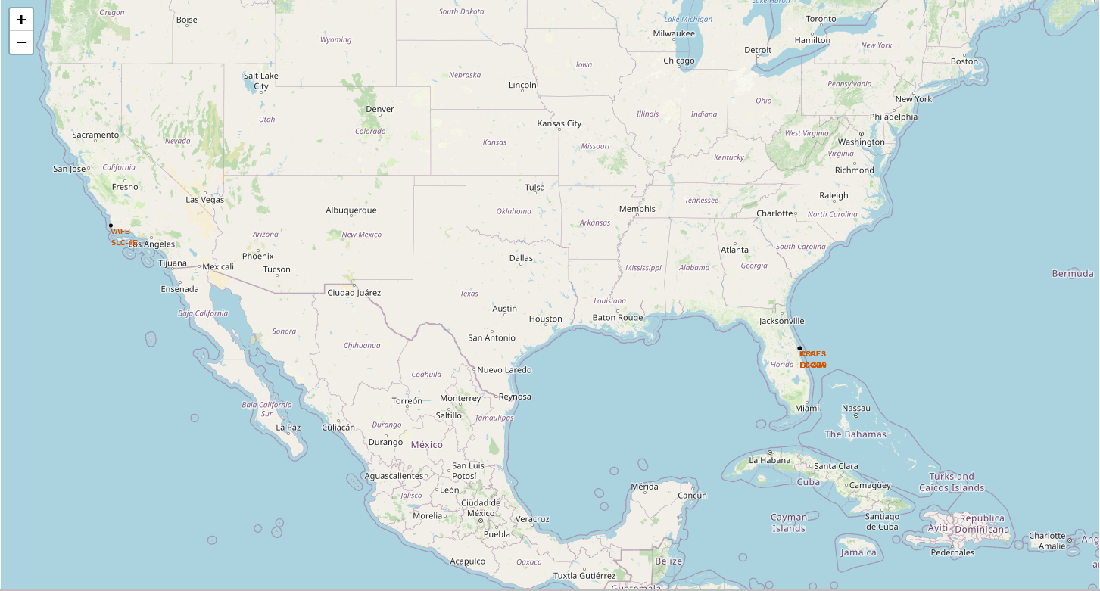
RESULTS
Marking Launch Sites on the Map

Slide 15
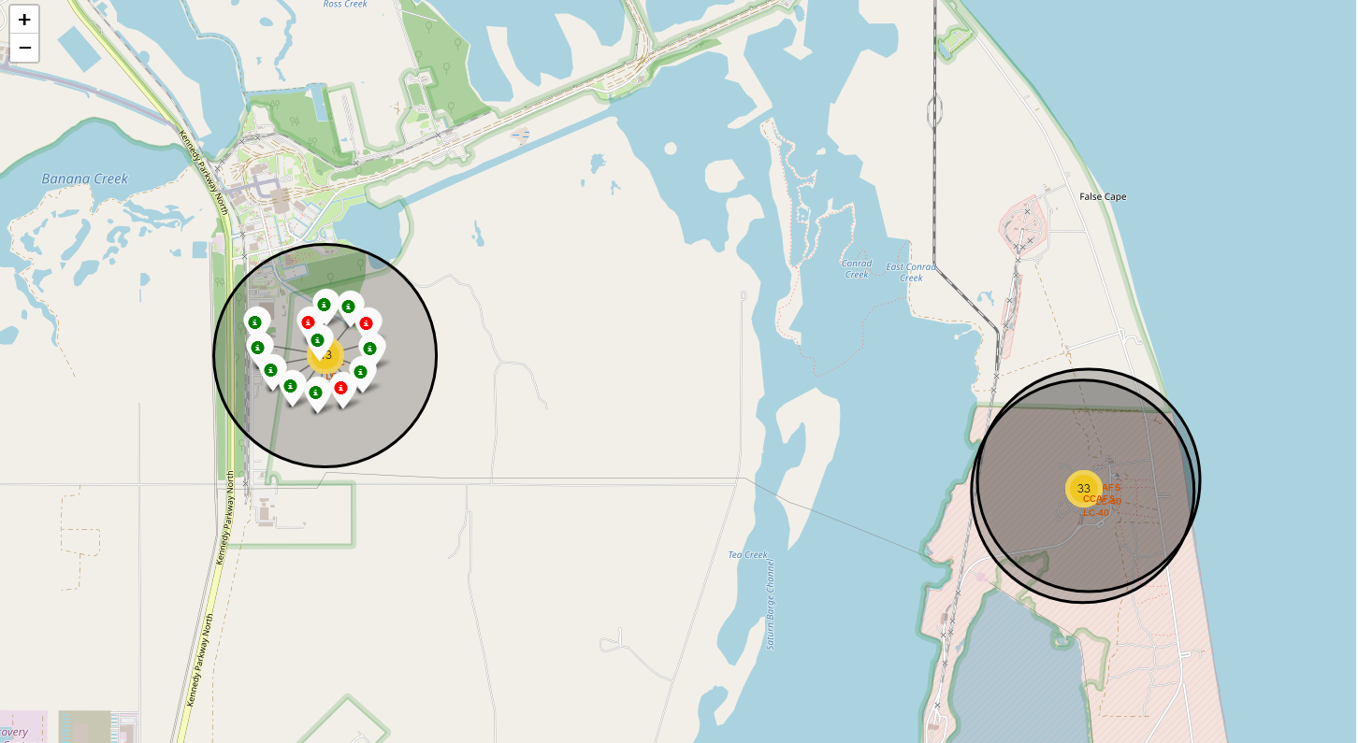
RESULTS
Using Clusters to showcase the
Outcome of the Launch
Red – Failure
Green – Success

Slide 16
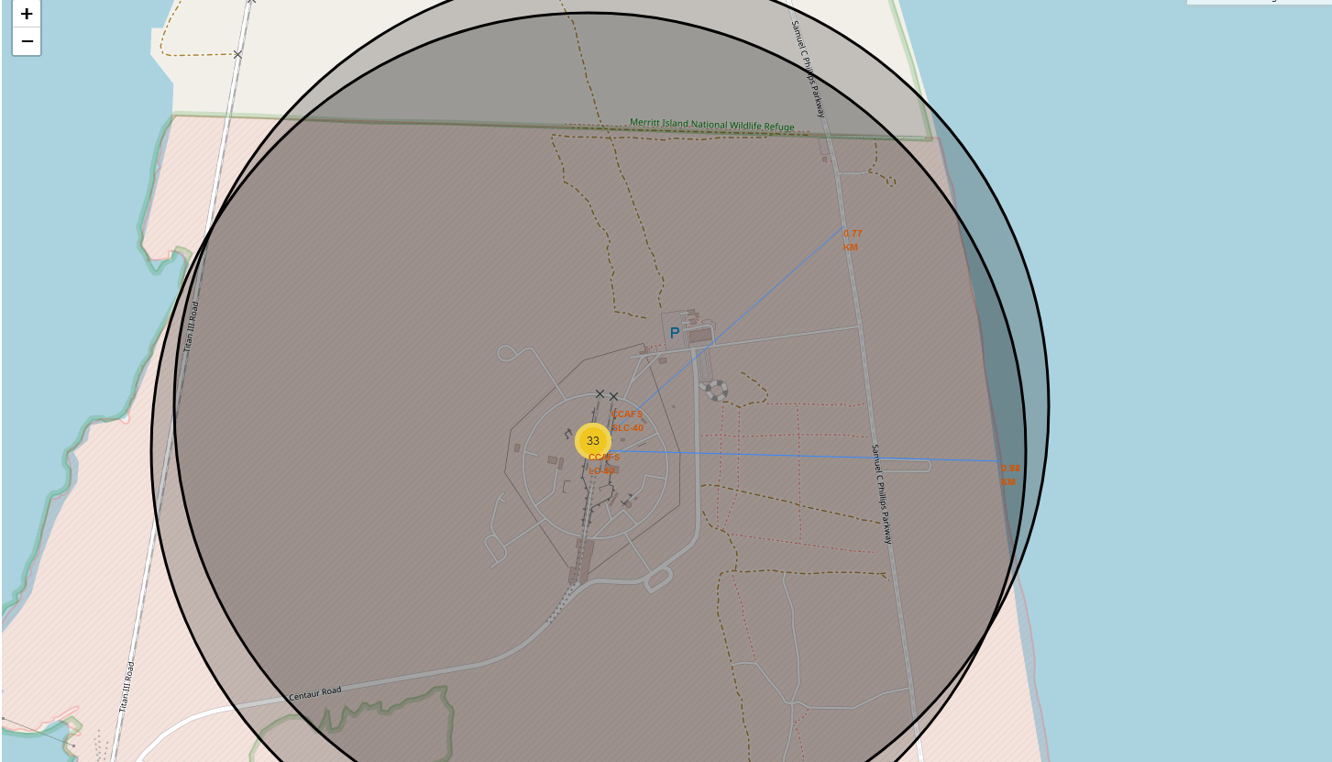
RESULTS
Calculated Distance between
Launch Site to its proximities

Slide 17
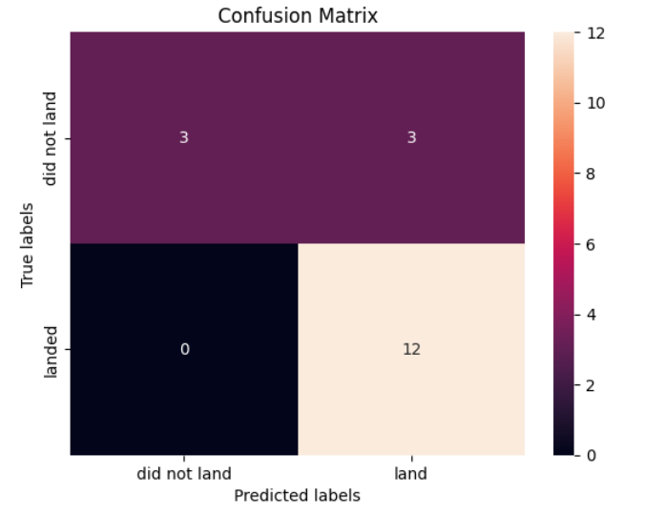
RESULTS
Used the Logistic Regression Model to train the model And used for Prediction.
The Accuracy obtained in this Model is -> 84.64%

Slide 18
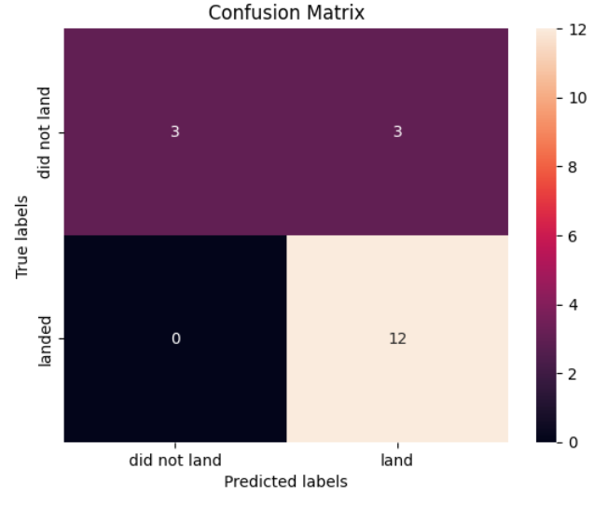
RESULTS
Used the Support Vector Machines (SVM) Model to train the model And used for Prediction.
The Accuracy obtained in this Model is -> 84.82%

Slide 19
RESULTS
Used the Decision Tree Model to train the model And used for Prediction.
The Accuracy obtained in this Model is -> 87.68%

Slide 20
RESULTS
Used the K-Nearest Neighbours Model to train the model And used for Prediction.
The Accuracy obtained in this Model is -> 84.82%

Slide 21
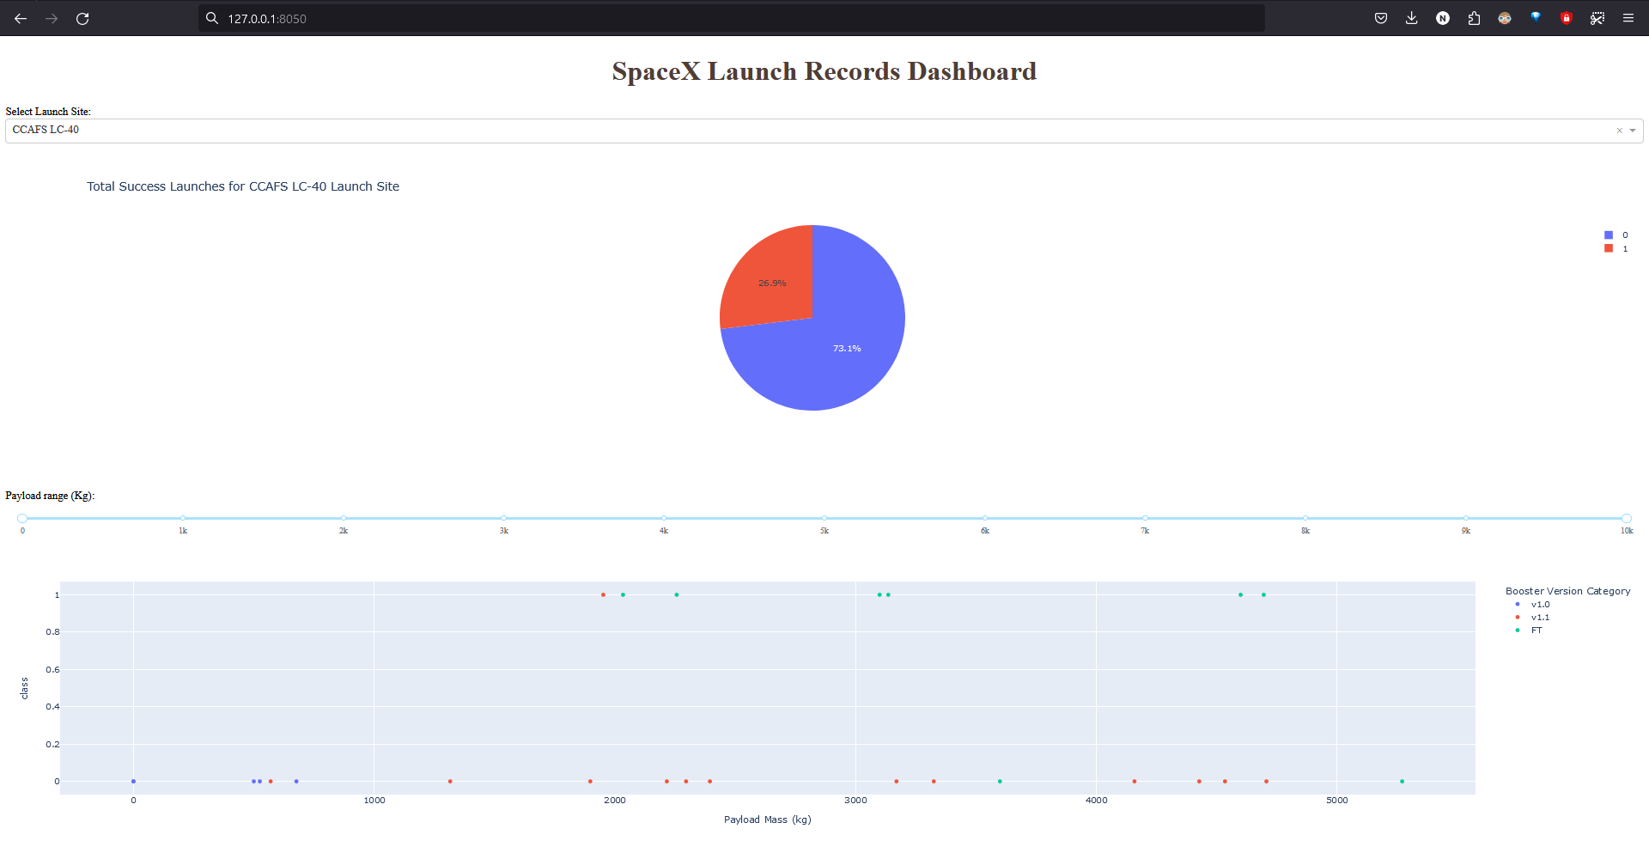
DASHBOARD
This snapshot of our comprehensive dashboard encapsulates key insights into the intricate relationships between Launch Site, Success Rate, Payload Mass, and Booster Version—a culmination of our data analysis efforts.
The essential findings from this dashboard snapshot are as follows:
Launch Site - CCAFS LC-40: The selected Launch Site, Cape Canaveral Air Force Station (CCAFS) Launch Complex 40 (LC-40), is associated with a Success Rate of 30%. This rate reflects the proportion of successful Falcon 9 rocket landings at this specific launch site, offering valuable insights into its performance history.
Booster Version - FT Most Successful: The dashboard snapshot highlights that the booster version denoted as "FT" has been the most successful among the analyzed variants. This insight underscores the significance of booster technology in achieving successful landings and mission outcomes.

Slide 22
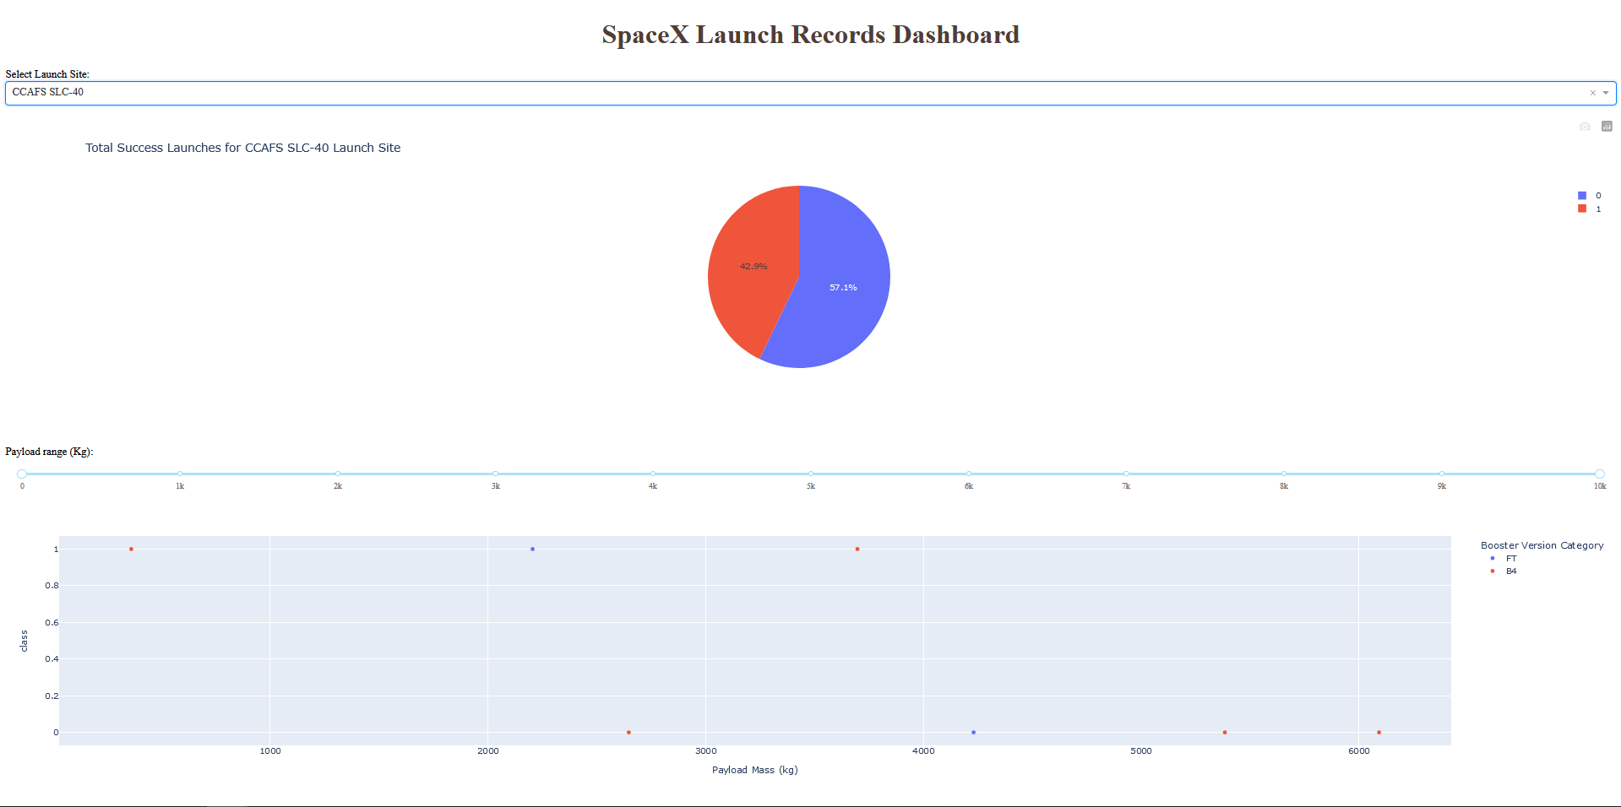
DASHBOARD
Launch Site - CCAFS SLC-40: The selected launch site, Cape Canaveral Air Force Station (CCAFS) Space Launch Complex 40 (SLC-40), has achieved a notable Success Rate of 43%. This statistic provides valuable context about the site's historical performance in facilitating successful Falcon 9 rocket landings.
Booster Versions - FT and B4: The dashboard snapshot reveals that two booster versions, denoted as "FT" and "B4," have played pivotal roles in Falcon 9 mission success at CCAFS SLC-40. The selection of these booster versions underscores their reliability and effectiveness in contributing to successful landings.

Slide 23
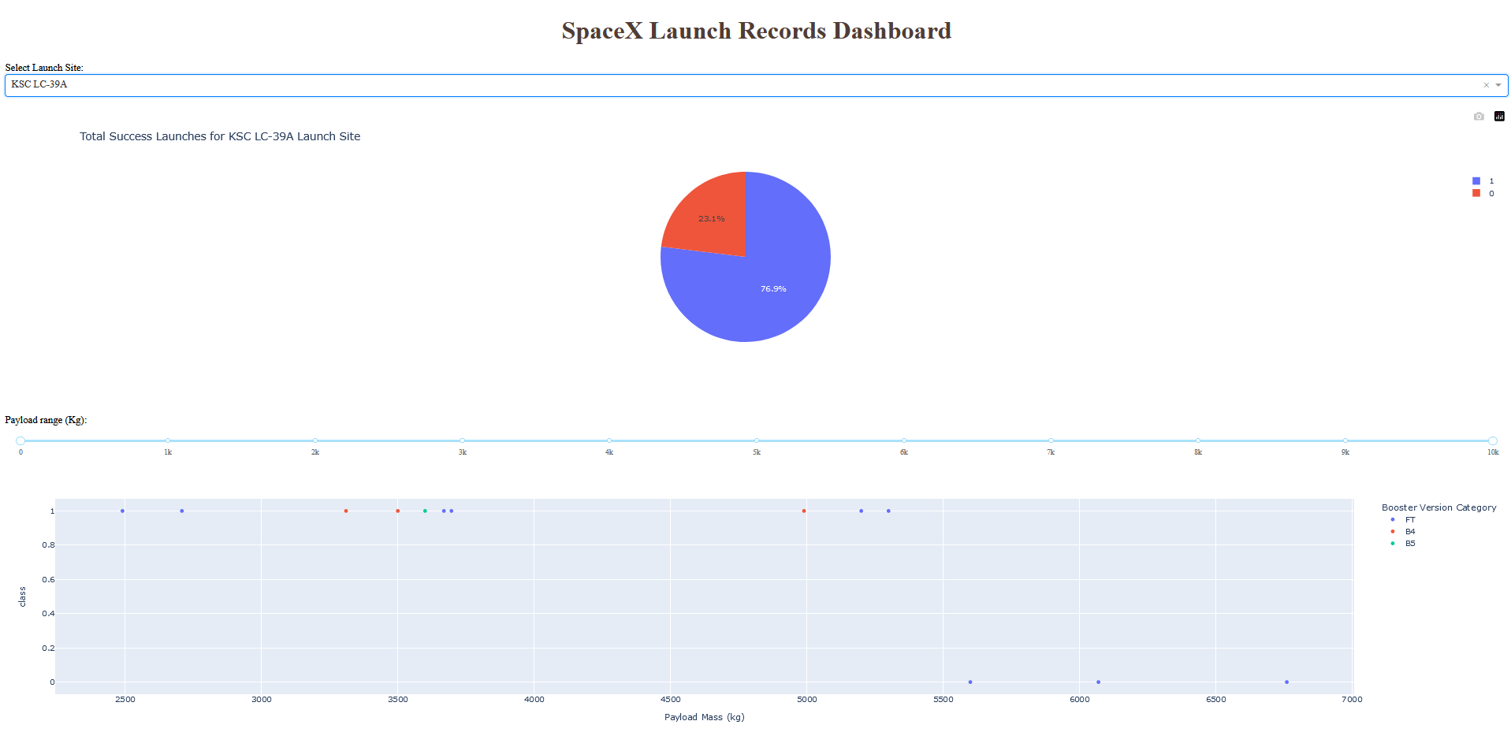
DASHBOARD
Launch Site - KSC LC-39A: The chosen launch site, Kennedy Space Center (KSC) Launch Complex 39A (LC-39A), boasts an impressive Success Rate of 77%. This remarkable success rate underscores the launch site's historical performance in consistently facilitating successful Falcon 9 rocket landings.
Booster Version - FT (most successful): The dashboard snapshot highlights that the booster version labeled "FT" has emerged as the most successful among the analyzed variants at KSC LC-39A. This specific booster's reliability and effectiveness have significantly contributed to the high success rate achieved at this launch site.

Slide 24
DASHBOARD
Launch Site - VAFB SLC-4E: The selected launch site, Vandenberg Air Force Base (VAFB) Space Launch Complex 4E (SLC-4E), has achieved a notable Success Rate of 40%. This statistic provides valuable context about the site's historical performance in facilitating Falcon 9 rocket landings.
Booster Versions - FT and B4: The dashboard snapshot reveals that two booster versions, denoted as "FT" and "B4," have played pivotal roles in Falcon 9 mission outcomes at VAFB SLC-4E. These booster versions have contributed to the success rate observed at this launch site, showcasing their significance in achieving successful landings.

Slide 25

DISCUSSION
Throughout the course of this project, our data analysis has uncovered five key factors that exert significant influence over the landing success of Falcon 9 rocket first stages. These factors, which encompass
Launch Site Performance,
Booster Version Impact,
Yearly Success Trends,
Orbit Type, and
Payload Mass Implications
Provide critical insights into the complexities of space exploration. Additionally, we have developed a dynamic dashboard that serves as a user-friendly interface, presenting snapshots of essential values for quick access and informed decision-making.

Slide 26
OVERALL FINDINGS & IMPLICATIONS
FINDINGS | IMPLICATIONS
Launch Site Performance | The Kennedy Space Center (KSC) Launch Complex 39A (LC-39A) stands out with a notably high success rate of 77%, while the Cape Canaveral Air Force Station (CCAFS) Space Launch Complex 40 (SLC-40) and Vandenberg Air Force Base (VAFB) Space Launch Complex 4E (SLC-4E) exhibit success rates of 43% and 40%, respectively.
2. Booster Version Significance | The booster version denoted as "FT" emerges as a common factor in high success rates at different launch sites. This raises questions about the unique characteristics or advancements associated with this booster version that contribute to its exceptional performance.
3. Yearly Success Trends | Analyzing the trend in success rates over the years reveals an overall increase in success rates from 2013 to 2020, with a slight dip in 2018
FINDINGS | IMPLICATIONS
4. Orbit Type Insights | Some orbits like Low Earth Orbit (LEO), Sun-Synchronous Orbit (SSO), and Highly Elliptical Orbit (HEO) exhibit consistently high success rates. In contrast, Geostationary Transfer Orbit (GTO) missions show more variability in success rates, indicating unique mission challenges.
5. Payload Mass Relationship | The analysis reveals that success rates vary based on Payload Mass, with heavy payloads demonstrating high success rates in specific orbit types. This raises questions about payload capacity and its implications for mission planning.
6. Dashboard Snapshot Significance | The utilization of the dashboard snapshots allows for quick access to critical insights, enhancing the decision-making process for mission planners, stakeholders, and space exploration teams.

Slide 27

CONCLUSION
In closing, this project represents a significant contribution to our understanding of Falcon 9 mission dynamics. The findings and tools generated here stand as a testament to the power of data-driven decision-making, innovation, and continuous improvement in rocketry. As we embark on future missions, armed with these insights, we are better equipped to push the boundaries of space exploration, expand our horizons, and embrace the challenges of tomorrow with confidence.

Slide 28

APPENDIX
Source of our Data Collections used in this project-
https://api.spacexdata.com/v4/launches/past
https://en.wikipedia.org/wiki/List_of_Falcon_9_and_Falcon_Heavy_launches

Slide 29
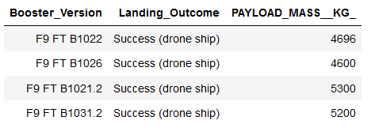

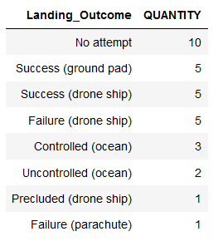
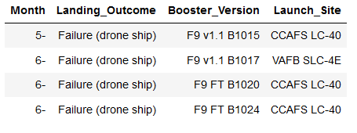
APPENDIX
We also done some SQL Query to find some hidden insights from our Data.

